Slide 1



Water balance-based tool for drought proofing agricultural watersheds
Sudharsan M, M F Alam, Alok Sikka, Shilp Verma
(International Water Management Institute)
Vijay V, Giresh Mohan, Akankshya Mishra (ITC)
s.Maliappan@cgiar.org

Slide 2

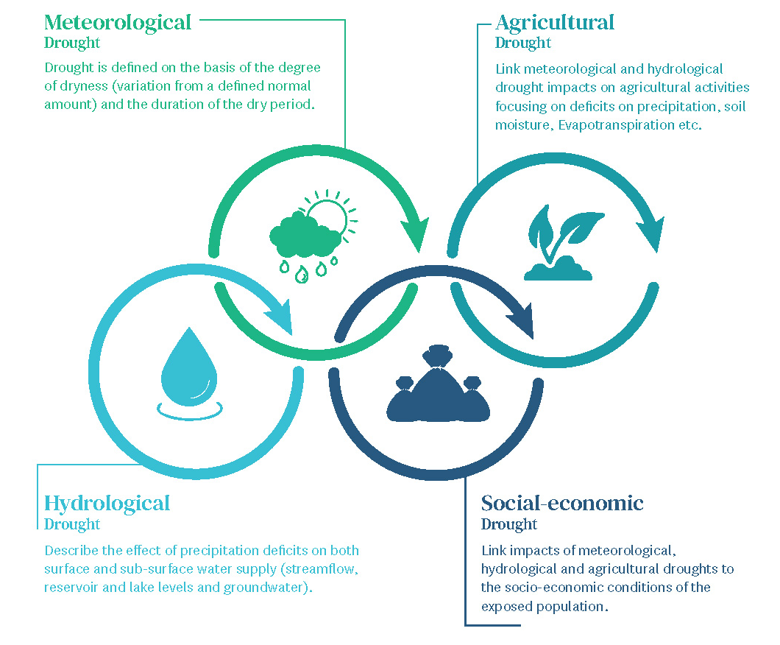
Drought overview
A temporary aberration but is a normal, recurring feature of climate
Agriculture is most vulnerable absorbing up to 80% of drought impacts, affecting agricultural production, food security and rural livelihoods
Spread and intensity of the drought depends on several factors:
Status of surface and ground water resources
Agro-climatic features
Cropping choices and patterns
Socio-economic vulnerabilities of the local population etc.
Drought classified under four major categories and Agricultural drought is considered for the study

Slide 3
Drought Proofing Agri-Catchments
Ensuring the capacity to meet the basic material and physical needs of the local population (both human and animal) during a drought so that there is minimal distress
In the context of agri- catchments
Drought proofing is defined as
“Preparing catchments to face drought with the minimum possible adverse effects by efficient and effective use of water resources with the objective of stabilizing crop production”
Outcome of stabilizing crop production: enhancing farmers’ drought resilience at micro level and stabilizing farm incomes.
Drought proofing is a continuous process and spans over both normal, drought and surplus years

Slide 4

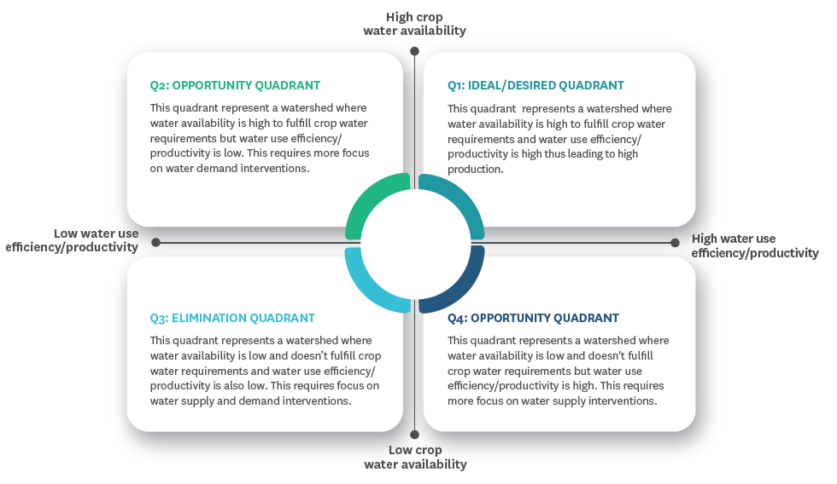
Conceptual framework

Slide 5
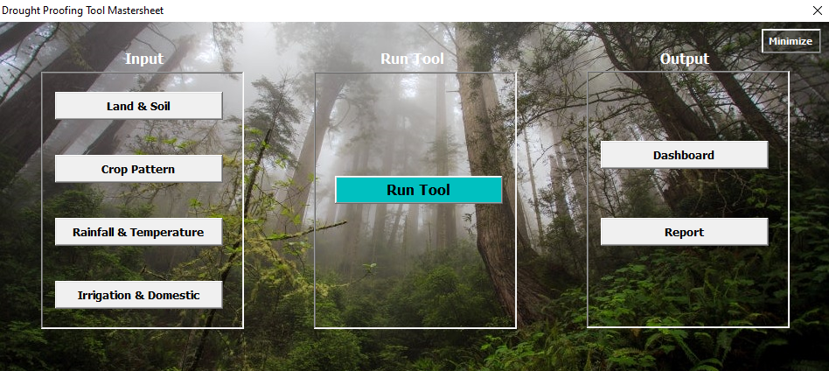
Water Balance Tool
To operationalize Drought Proofing Framework
To help in site specific water balance, crop yield and crop requirement assessments
Excel based, simple but conceptually robust
Inbuilt default datasets, minimum data requirements
Simulate scenarios to assess impact of planned interventions on drought proofing
Average, monthly and annual results

Slide 6
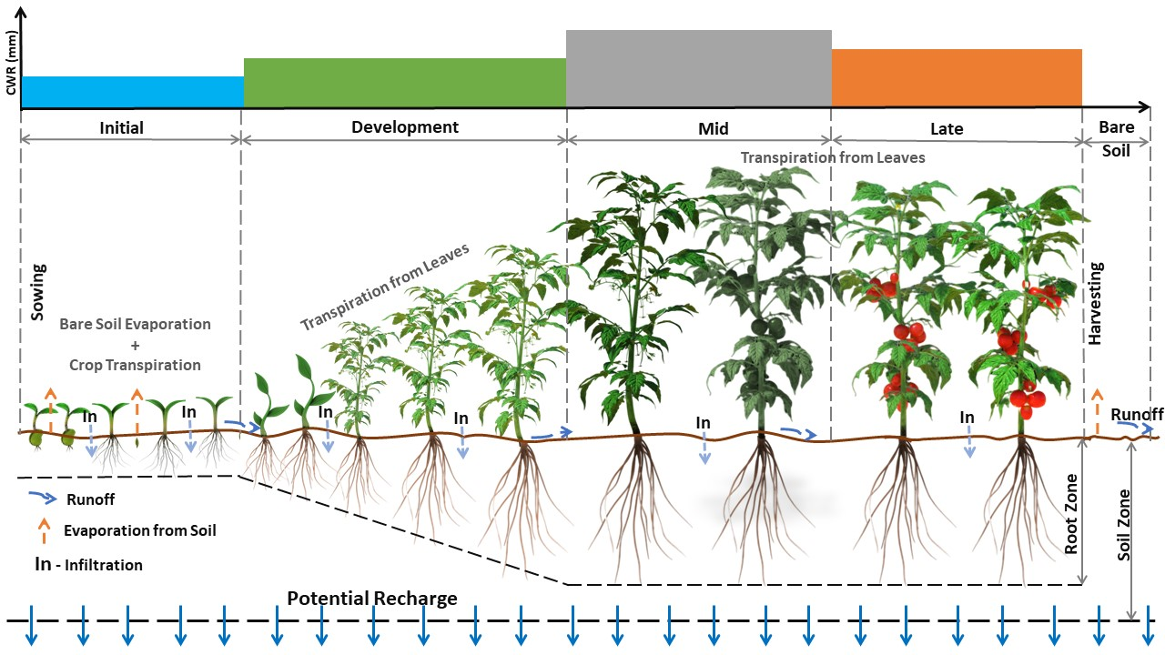
Robust Methodology (Backend)
FAO 56
FAO Crop yield response
USDA CN
Dynamic root growth
Daily soil moisture and stress

Slide 7
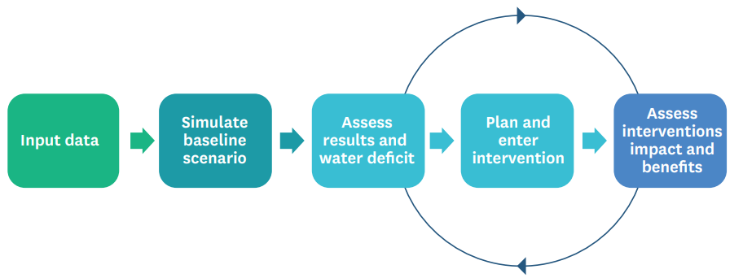
Water Balance Tool: Steps Involved

Slide 8


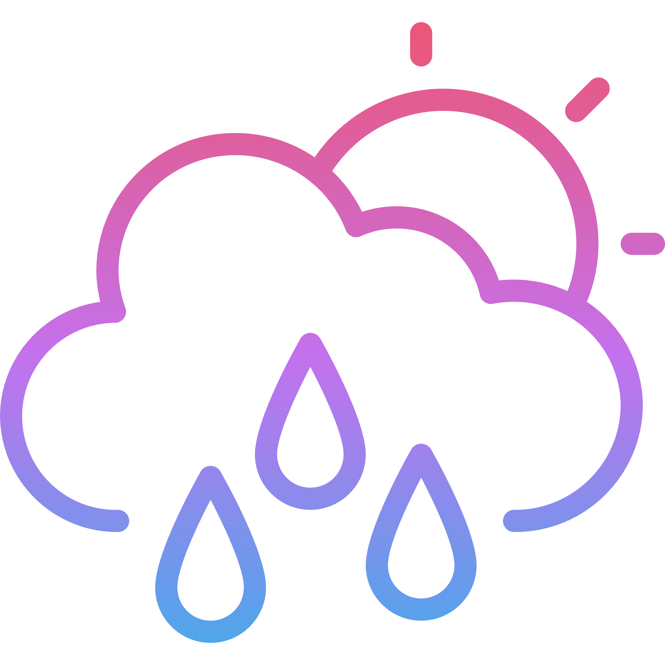
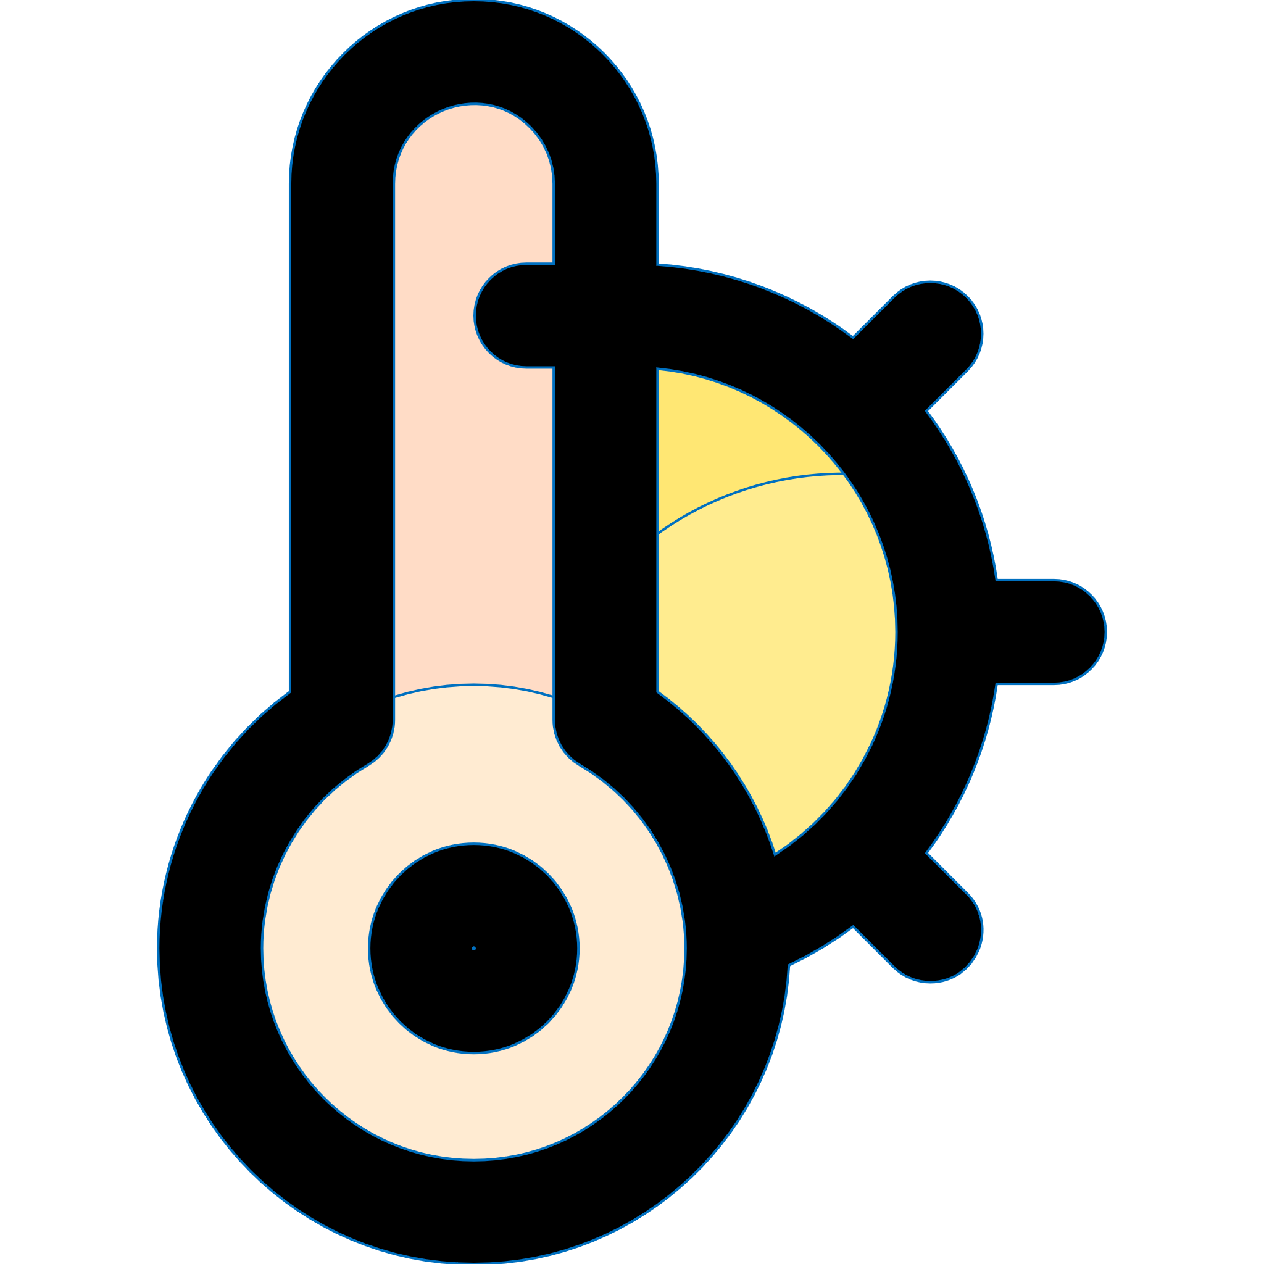


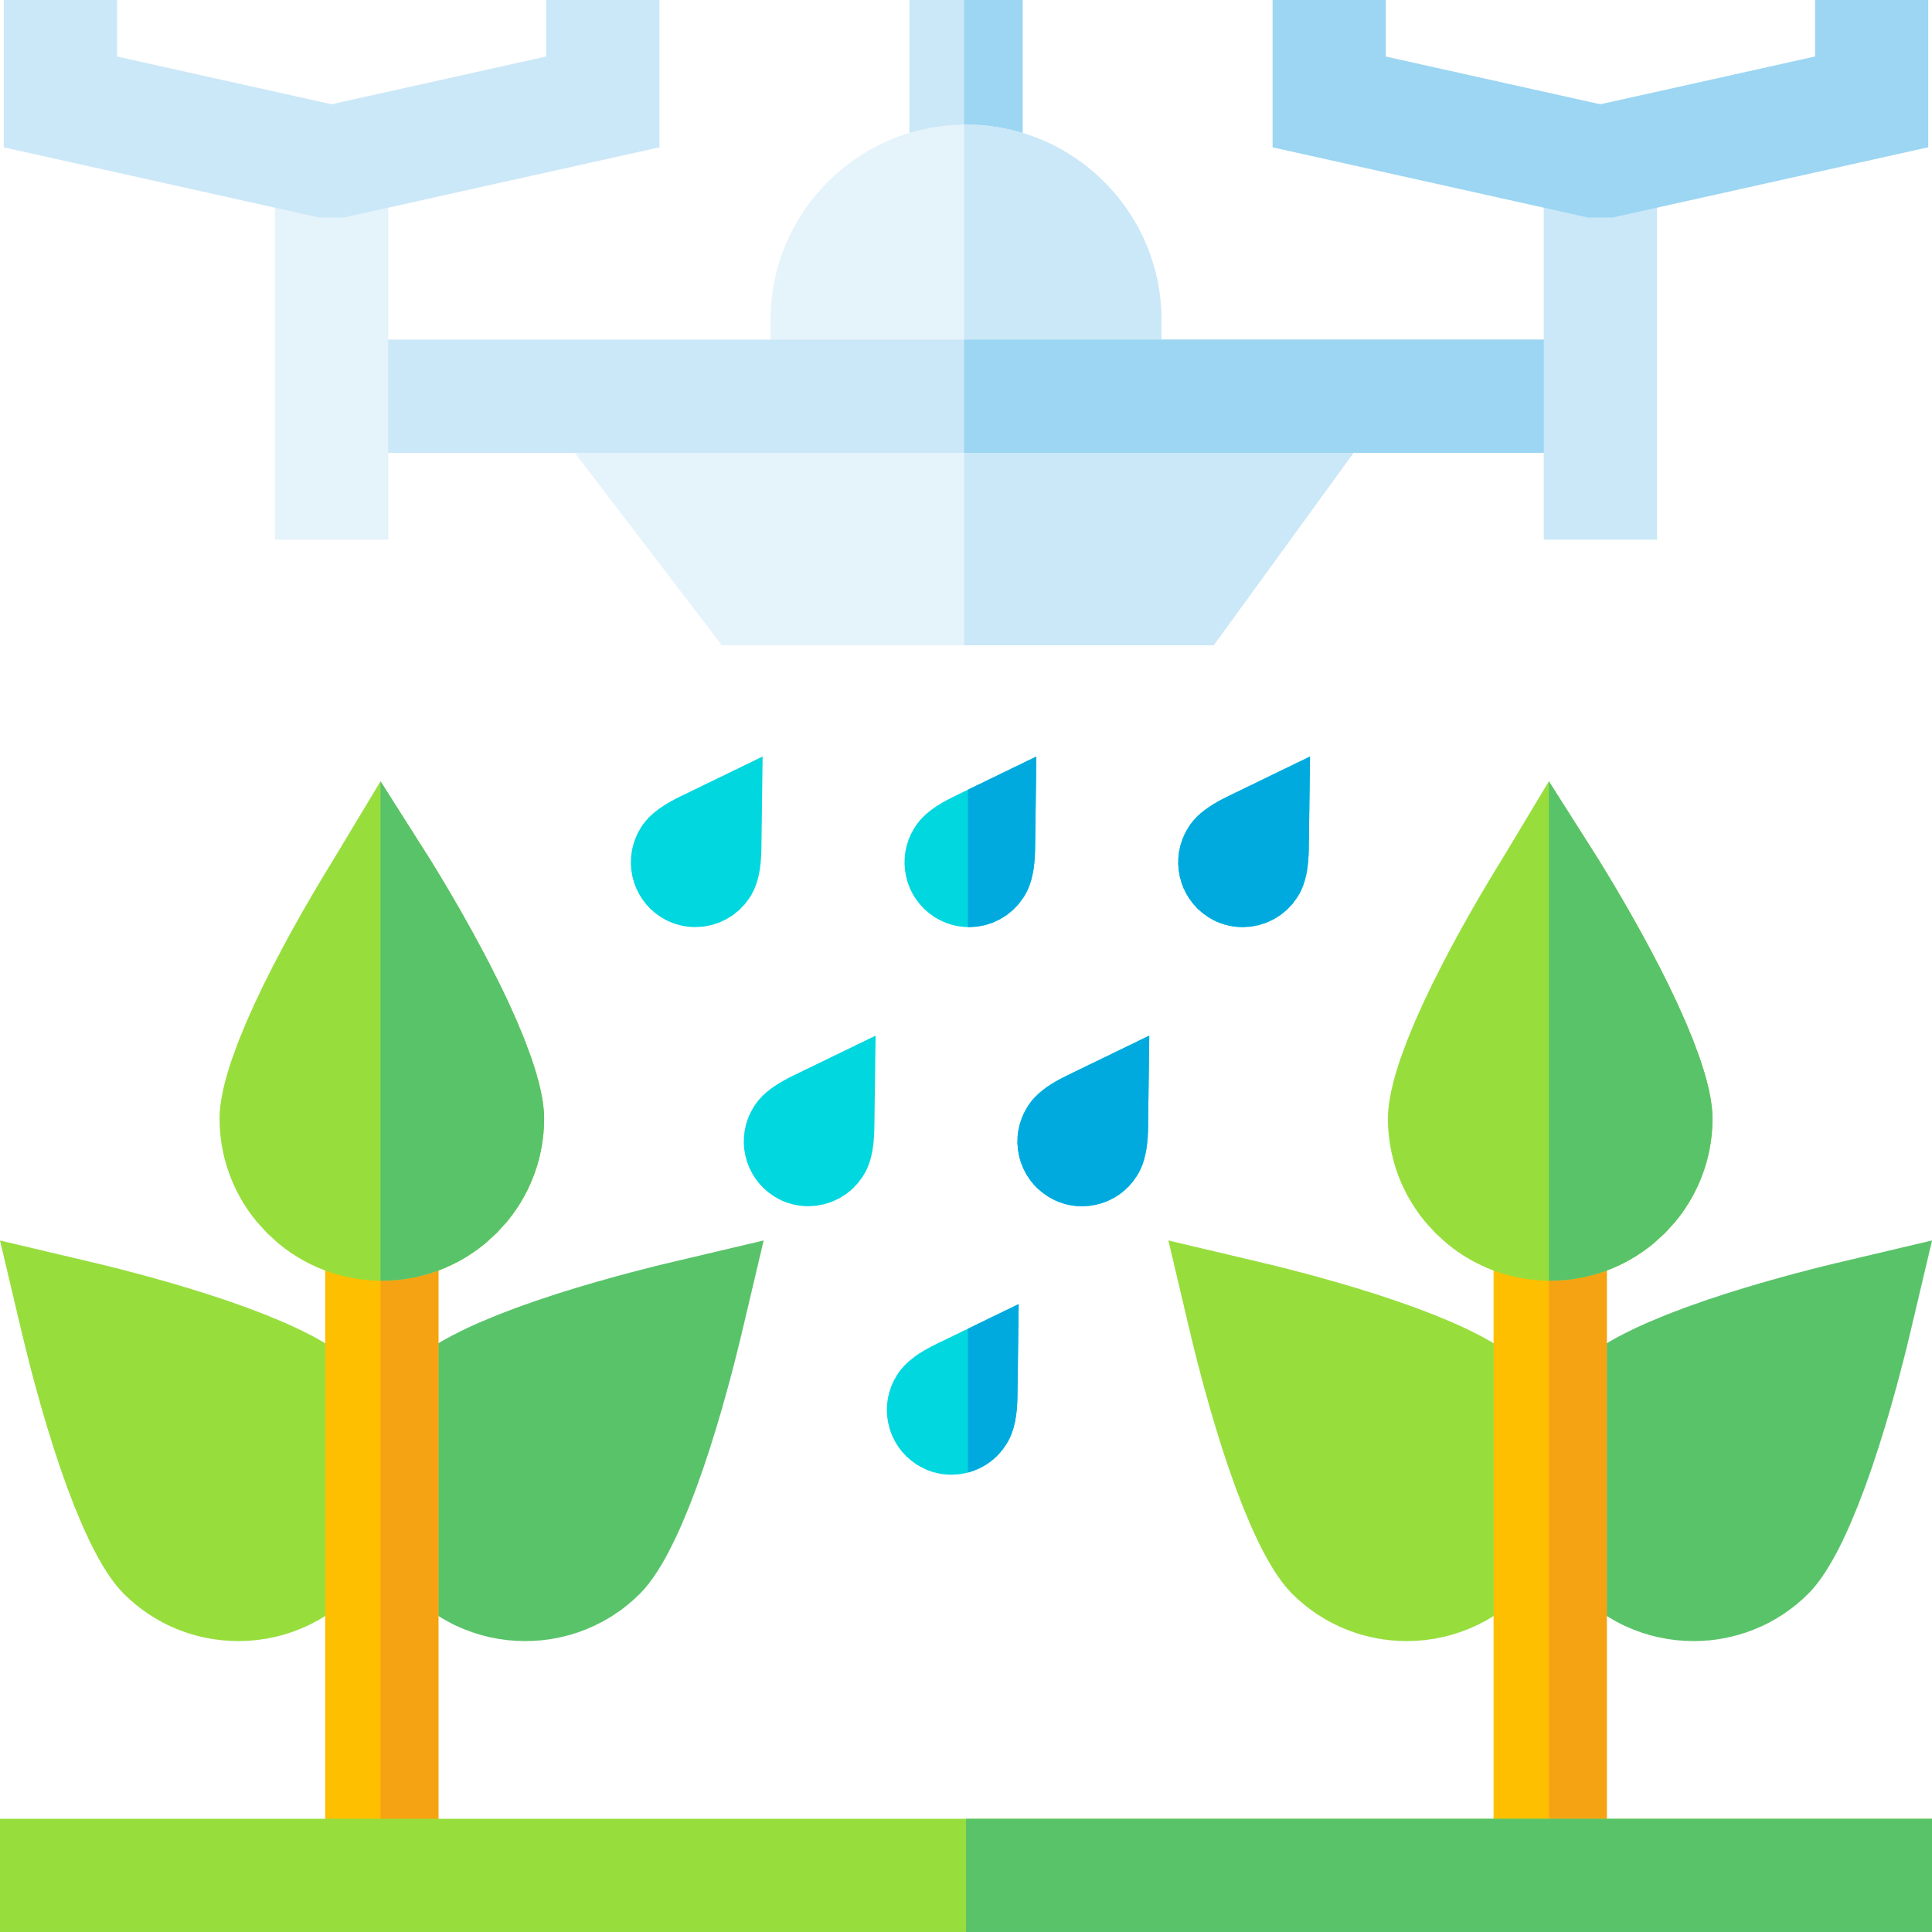
Easily acquired input Parameters
User Inputs
Land Use & Soil
Soil Types, depth & Distribution
Hydrological condition
Land Use Land Cover Data
Latitude & Hemisphere
Rainfall & Temperature
Daily Rainfall data
Monthly Min & Max temperature
Crop Pattern
Crop Type and growth duration
Upto 9 crops
Rainfed & Irrigated area
Sowing Month & Week
Irrigation & Domestic
Irrigation Efficiency
Groundwater & Surface water dependency (%)
River / Canal water availability
Population & daily water usage

Slide 9
Inbuilt data
Inbuilt Database
CN, Radiation | Matrix of land use & Soil Solar radiation
Soil | Infiltration rate Field capacity Wilting point
Crops (45+) | Crop growth duration Crop coefficient Yield response factor Root depth Crop yieldPrice Depletion factor Return flows
Intervention | Impact of water balance components, costs..
Supply Side Interventions
Increase Groundwater Storage
Demand Side Interventions
Increase irrigation efficiency
Save Water
Soil Moisture Interventions
Reduce Runoff & Soil Evaporation
Increase moisture holding capacity of Soil

Slide 10
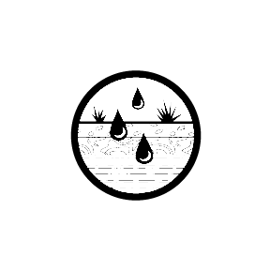
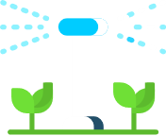

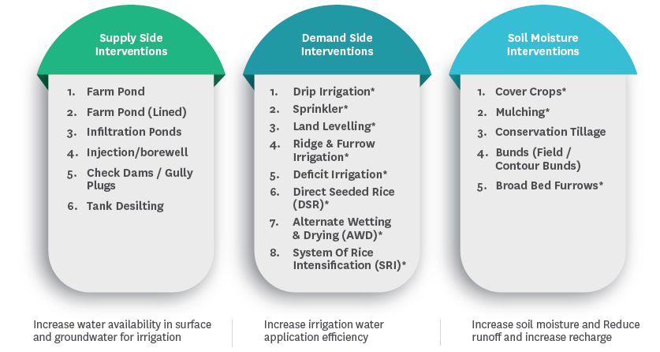
Inbuilt Water Management Interventions
Supply Side
Interventions
Demand Side
Interventions
Soil Moisture
Interventions
Farm Pond
Farm Pond (Lined)
Infiltration Ponds
Injection/Borewell
Check dams / Gully Plugs
Tank desilting

Slide 11
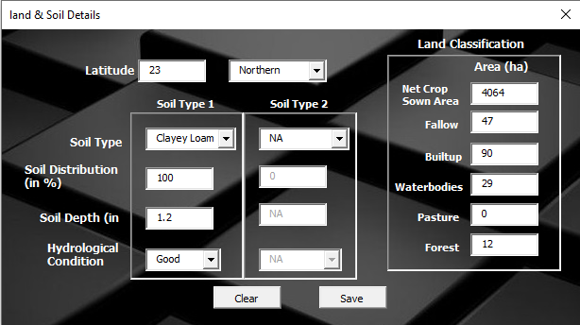
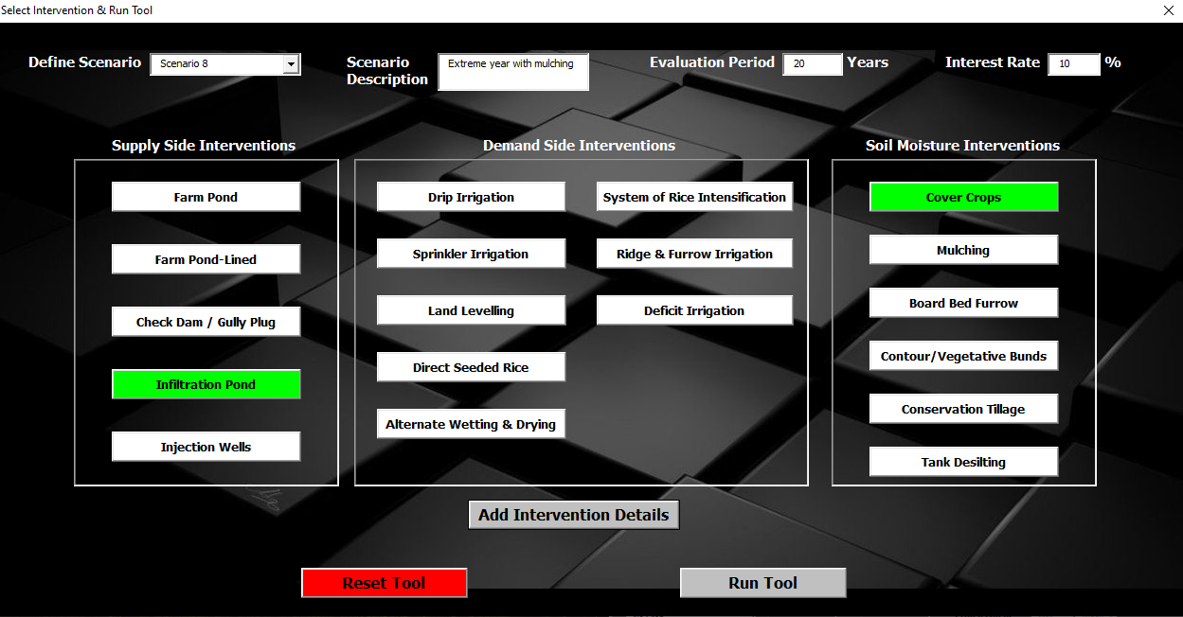
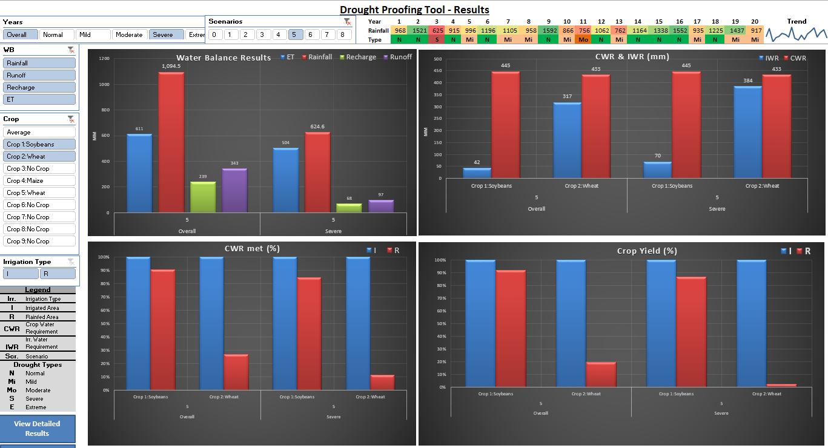
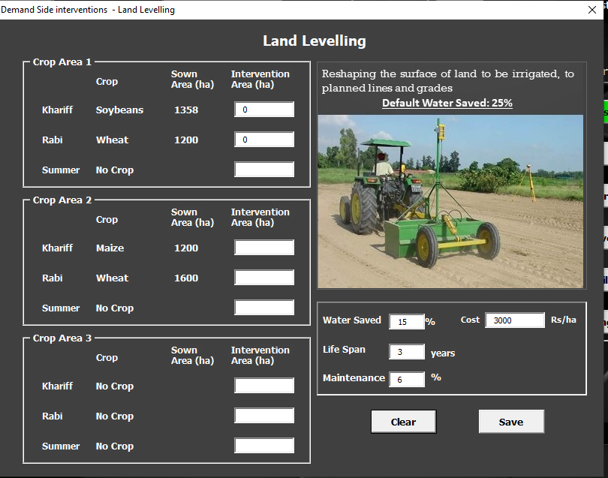
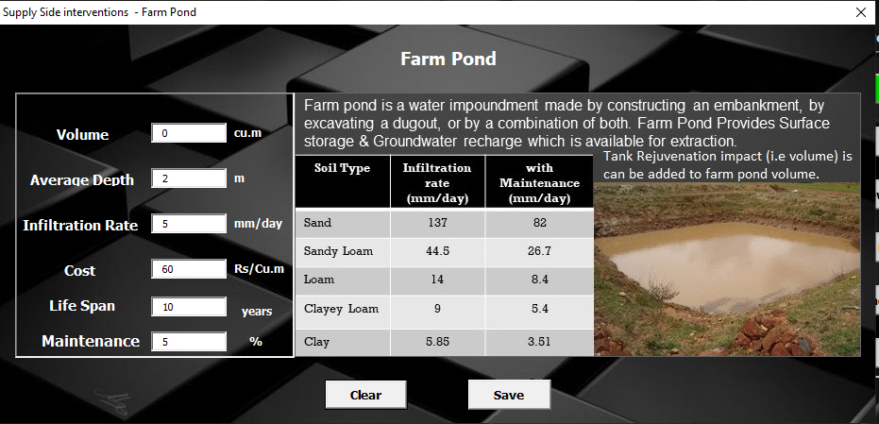
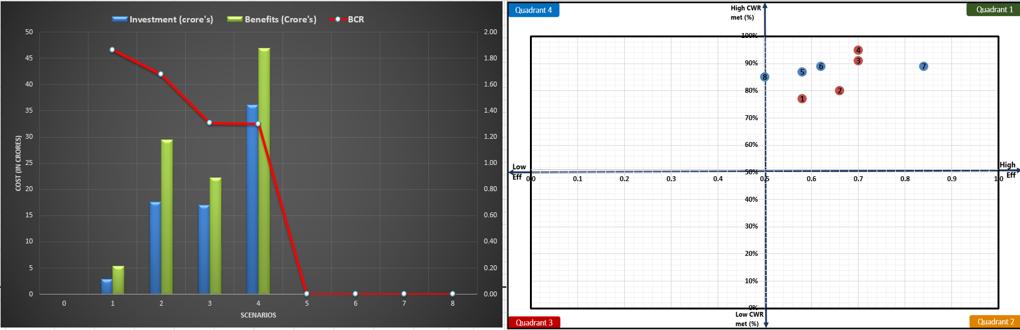
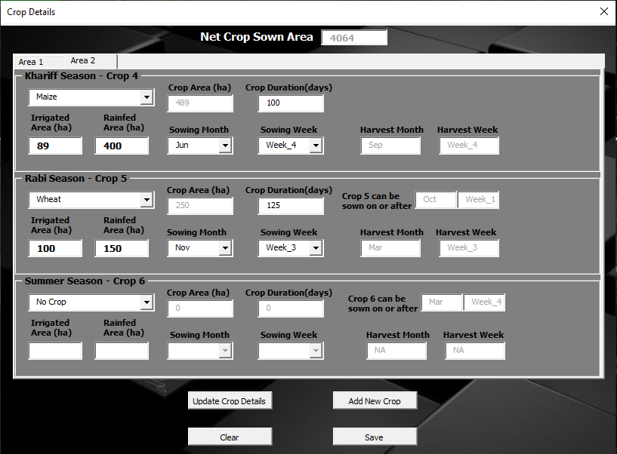

Slide 12
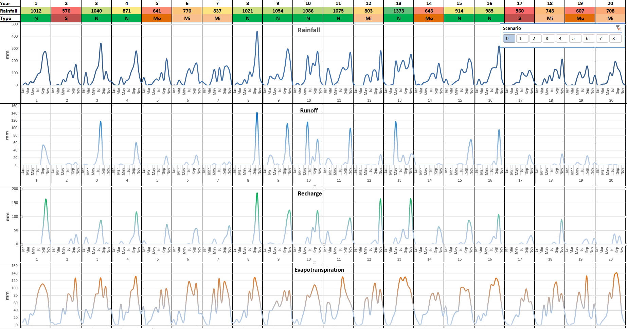
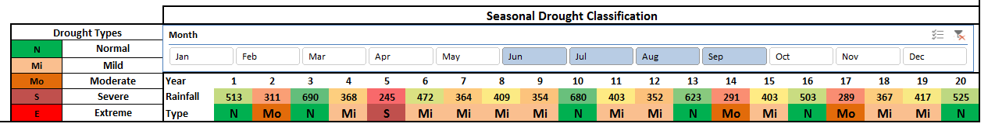
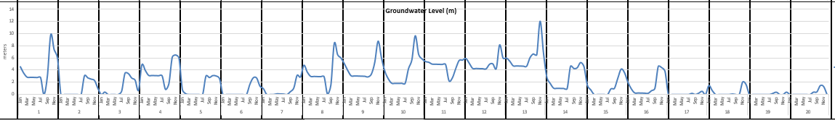

Slide 13


What it is?
Limitations > To be developed
Simple tool for field level NGO partners
To assess water availability and requirements
Gives an idea what interventions to plan and what potential benefits will be
Prepare DPR
For small (10-100 km2) homogenous agri-catchments
Easy to use, no software requirements (other than excel)
Not a replacement for sophistical models' researchers can use and understand
Not for large watersheds with heterogeneity
Lumped. Not for identifying sites for interventions within watershed
Water specific drought proofing

Slide 14
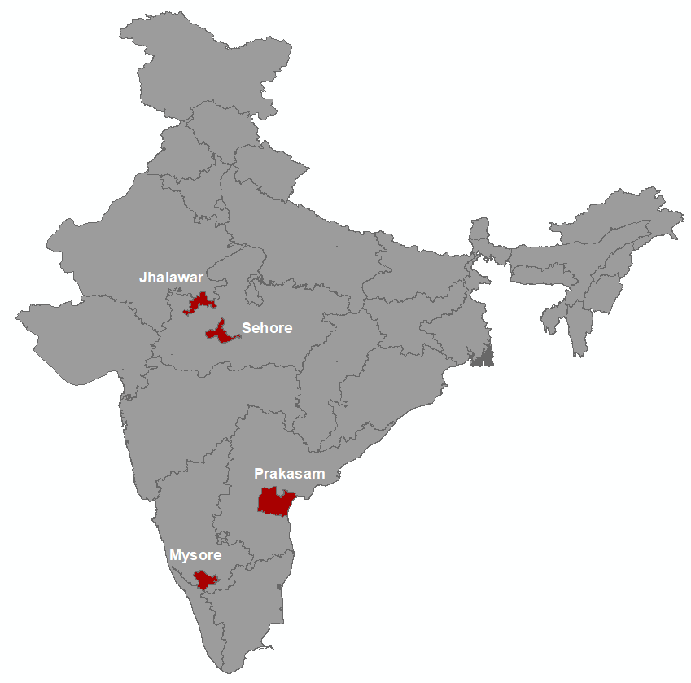
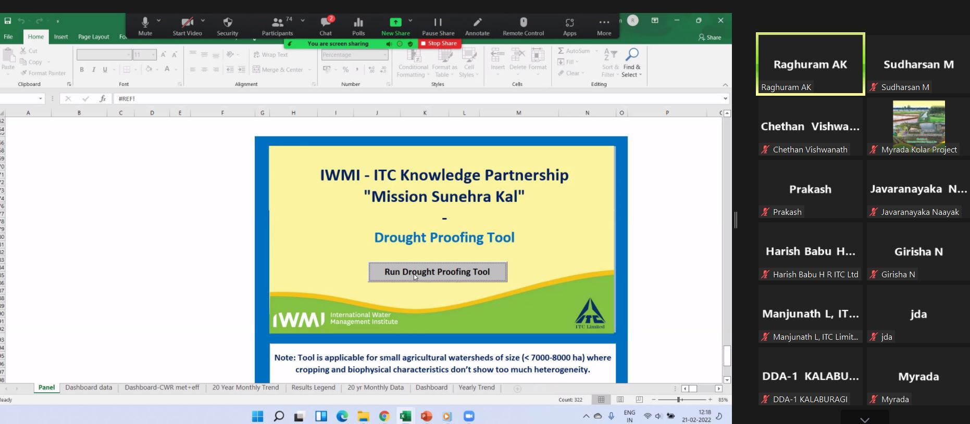
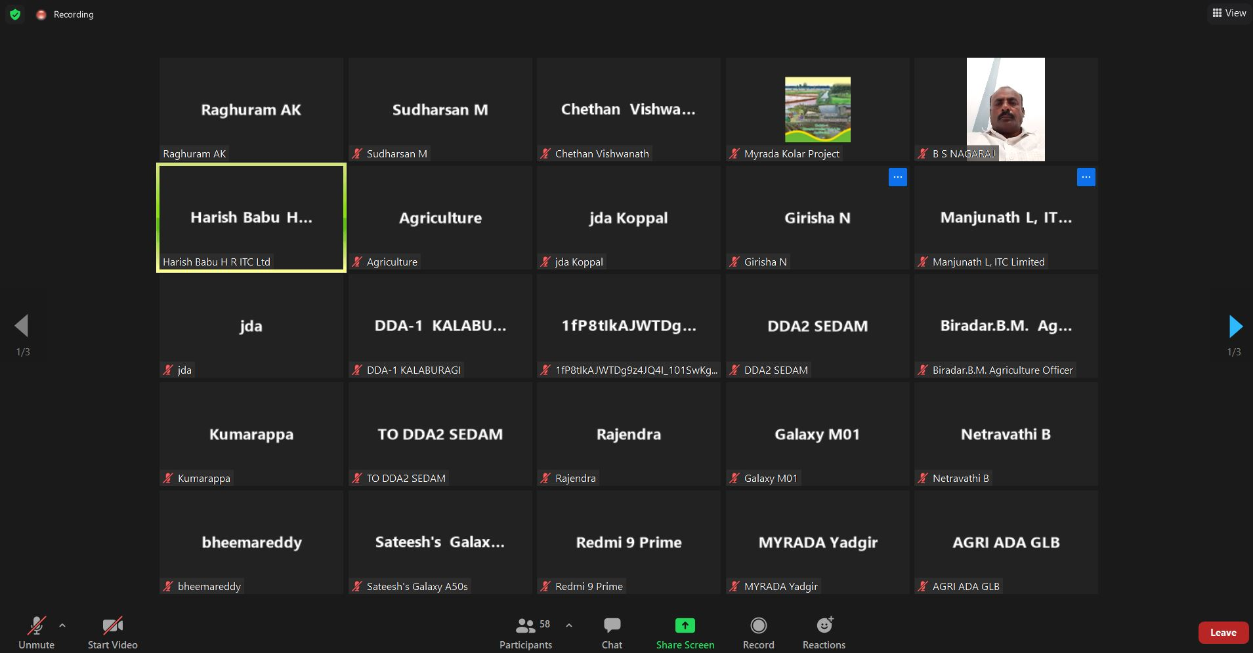
Tool is currently used by ITC and associated NGO partners for planning interventions
Tool is planned to be used Karnataka Watershed department for actively planning interventions in 100 watersheds in 1.16 million acres
Training program to Watershed Development Department (WDD), Karnataka to implement drought framework and tool to plan and implement interventions

Slide 15
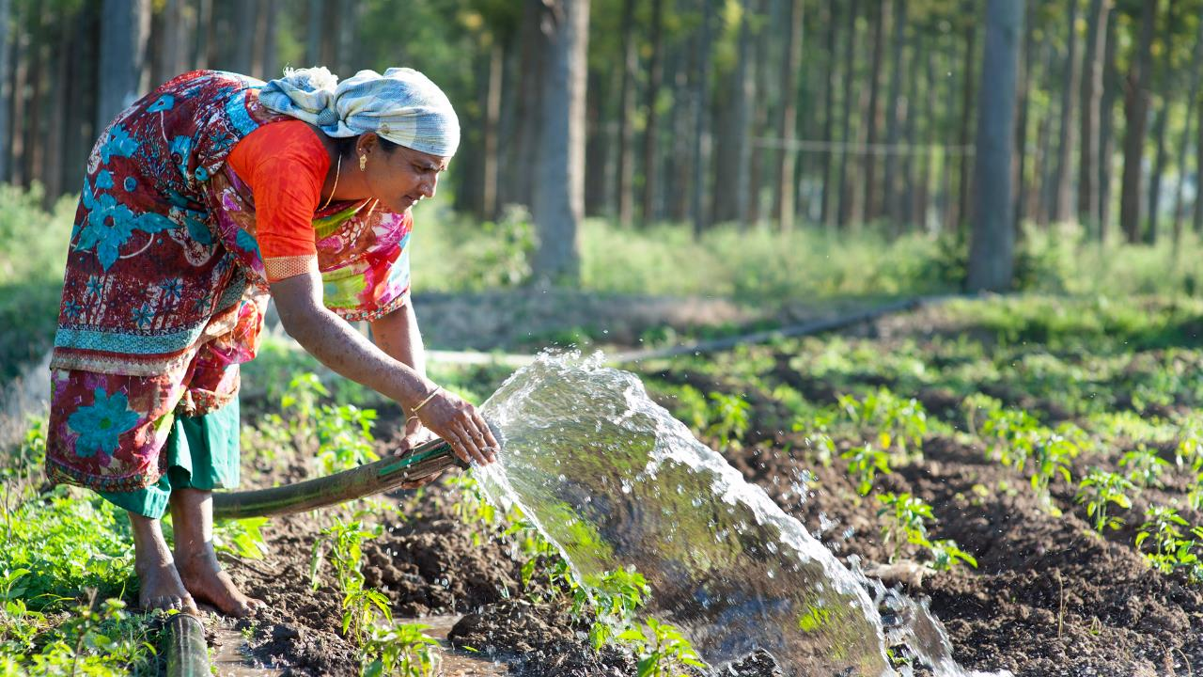


Thank you

